Slide 1

COVID19 & People using Public Transport
By the DATA DIVAS: AN NGUYEN, ARRON NGUYEN, RAKHI ROY, MEHRDAD MALEKI & KEVIN SWARTZ

Slide 2
Purpose: Investigate the relationship between the number of COVID cases and changes in people’s movements on public transport.
In a hypothetical situation where we represent a national public transport operator for the whole of Australia. Supposedly, like most companies who were hit hard in 2020 because we were ill-prepared, and did not anticipate the reactions and behavioural responses to COVID by Australians and their governments.

Slide 3
Background
In a bid to reduce operational costs and increase efficiencies, we’ve been tasked with determining what level of public transport services we should provide (by state) for Australia. But more importantly, what contingencies should be put in place in the event of similar re-occurrences in future.
Our aim is to apply what we’ve analysed from COVID and movement data for the past 12 months and use that to forecast the need to increase or decrease public transport services for every state in Australia.

Slide 4
INTENDED LEARNINGS
During the peaks of COVID-19 cases in Australia, what were the changes in movements of Australians around their natural environments?
Is there any correlation between rising case numbers and changes in people’s movements on public transport?
Can we use the analysis of this data to predict future behavior during similar situations?
What would be the advantage of being able to predict people’s movement patterns in similar situations?

Slide 5
Premise
For us to answer our questions, we need to have a good understanding of people’s movements in response to changing COVID case numbers.
For this we need accurate reliable data that shows the number of reported COVID cases by date and location.
Similarly, we also need data that provides insight into people’s movements during the same period (date) and location, measured against pre-COVID movement (baseline)
The baseline is the median value of mobility data for the corresponding period pre-COVID
Ideally, we should include movement trends across various categories of places
The premise is that these two data sets will help us compare COVID case numbers vs mobility and isolate important trends and behaviors

Slide 6
Source data

Slide 7
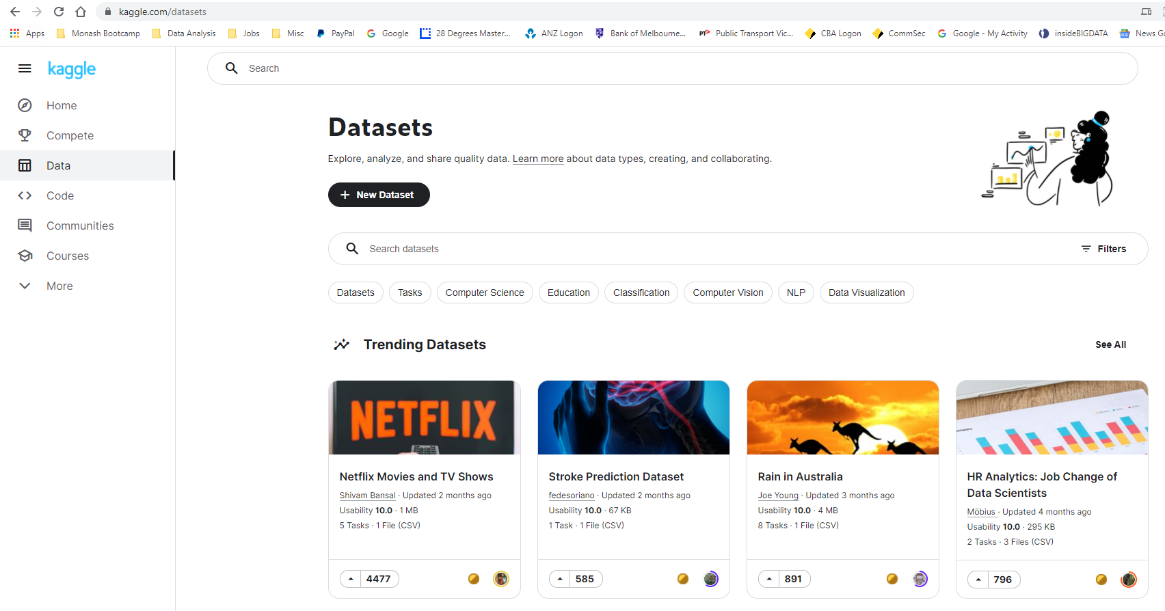
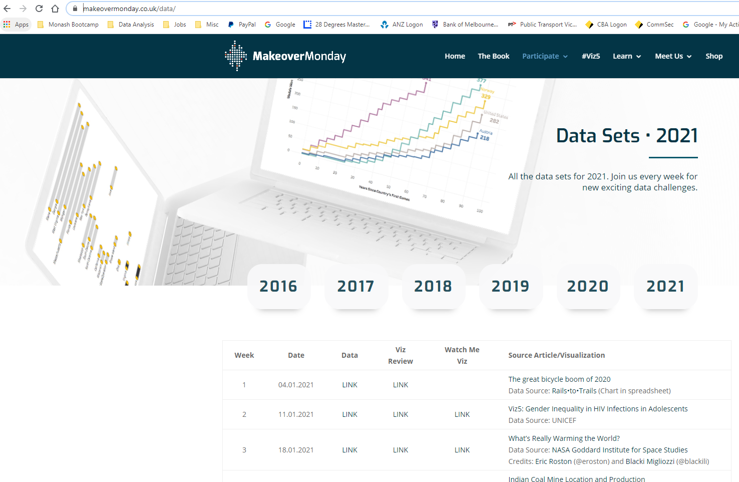
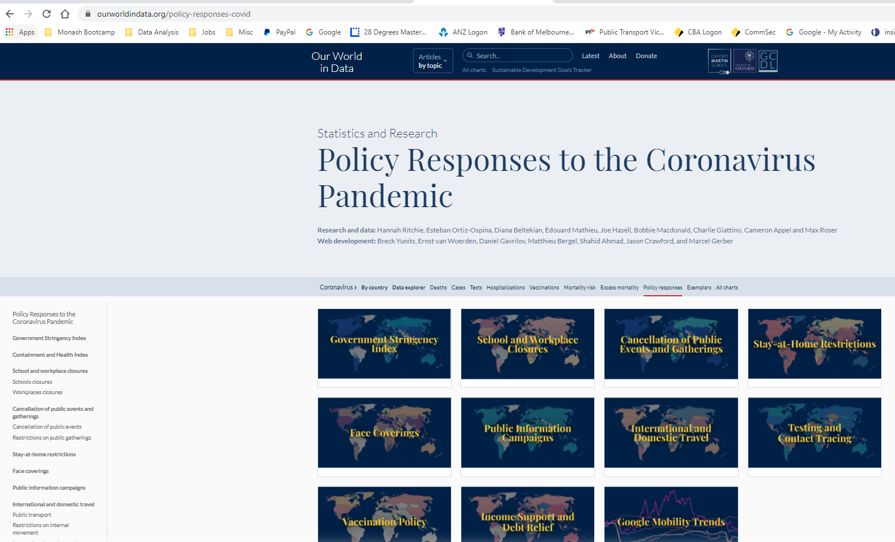
Source Data
Kaggle
https://www.kaggle.com/datasets
Makeover Monday
https://www.makeovermonday.co.uk/data/
Our World in Data
https://ourworldindata.org/policy-responses-covid

Slide 8
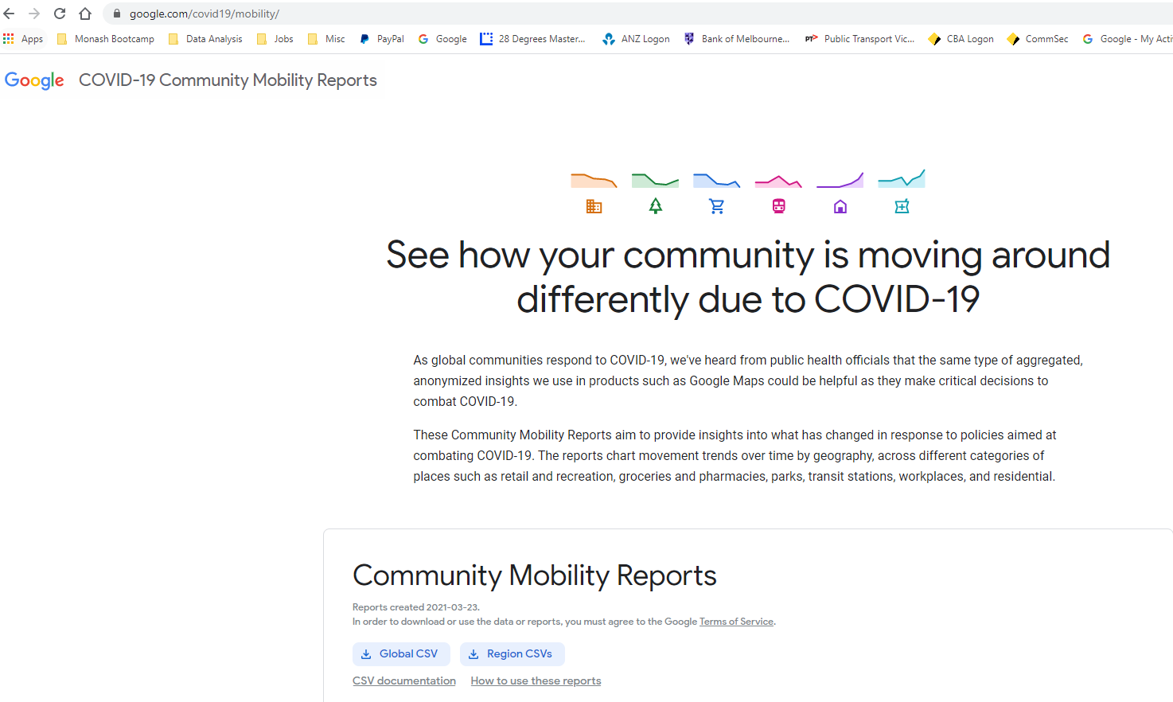
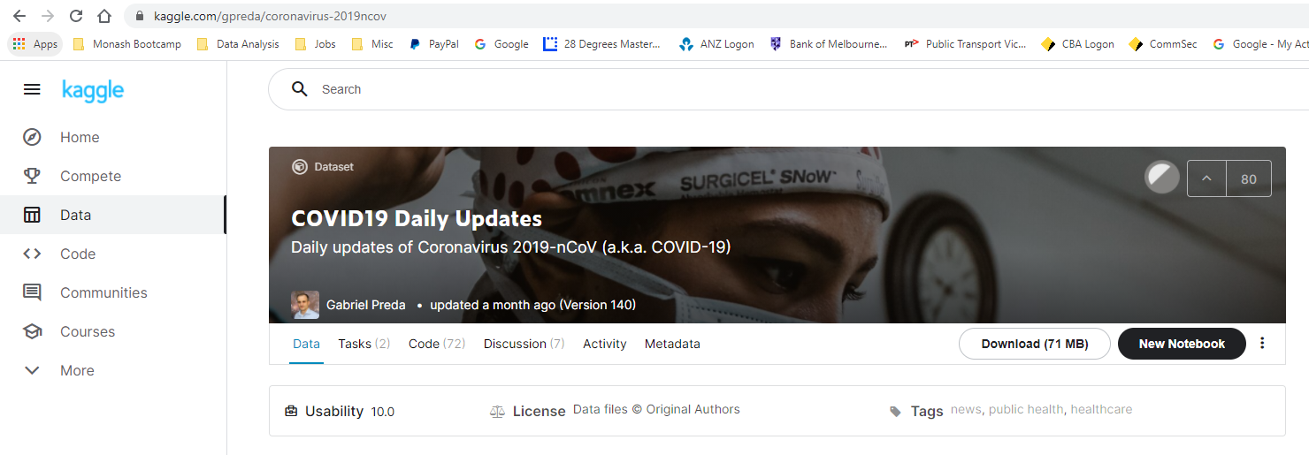
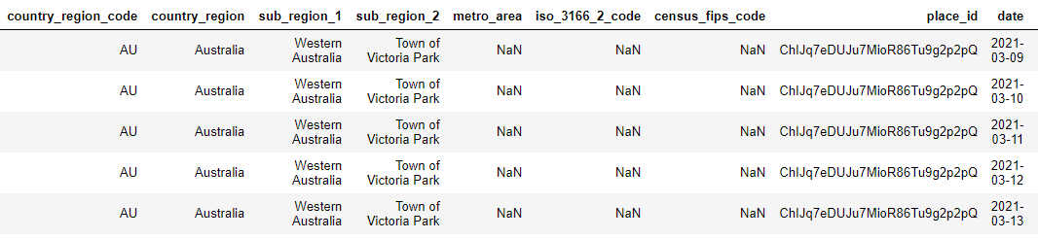
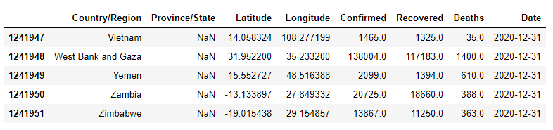
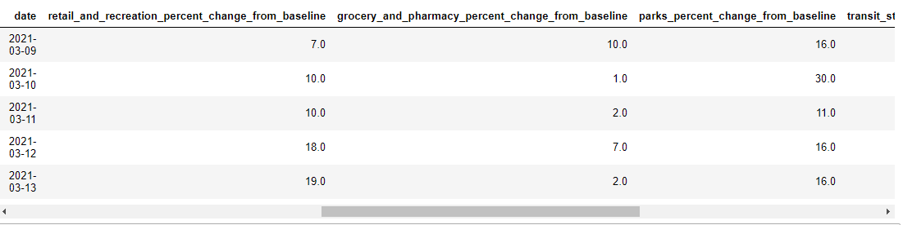
Final Source Data
Google – Community Mobility Reports
https://www.google.com/covid19/mobility/
Kaggle – COVID19 Daily Updates
https://www.kaggle.com/gpreda/coronavirus-2019ncov

Slide 9
CATEGORIES OF MOBILITY
retail_and_recreation_percent_change_from_baseline
grocery_and_pharmacy_percent_change_from_baseline
parks_percent_change_from_baseline
transit_stations_percent_change_from_baseline
workplaces_percent_change_from_baseline
residential_percent_change_from_baseline

Slide 10
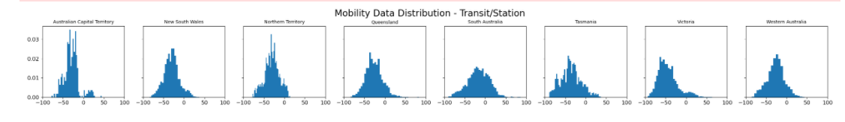
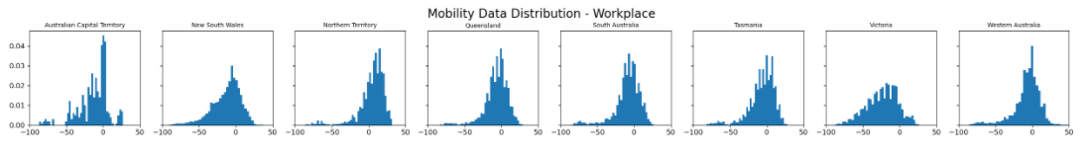
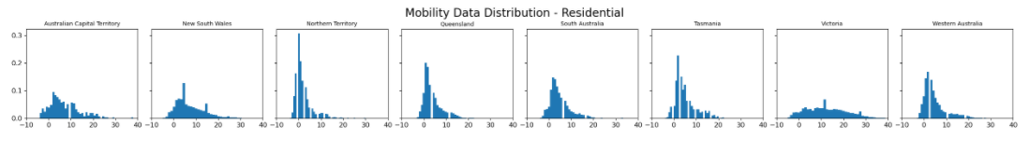
DATA PREPARATION
Data cleansing to search for missing state via Google APIs and CitiPy Python library
Grouping of mobility data from city council area level to state level, and using median as the measure of central tendency.
Merging both COVID19 daily data and Google mobility data together on Country, State and Date parameters.\
Is it appropriate to use median instead of mean to group the mobility data?
Data distribution of the main interested mobility categories by each state, the non-normally distribution suggested that median should be used.

Slide 11
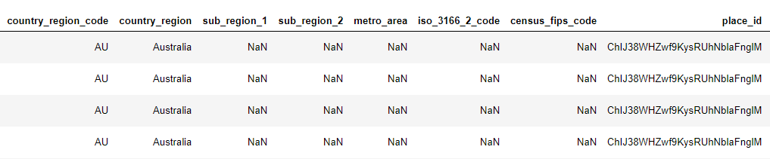
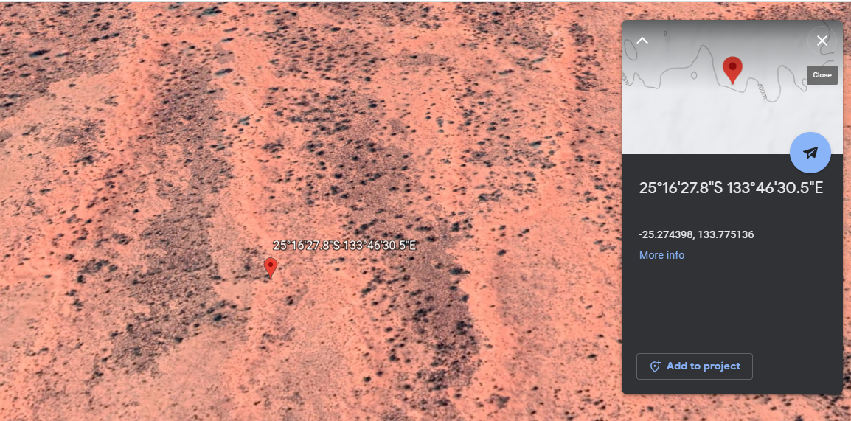
CHALLENGES IN FINDING THE NULL STATE
The only location parameter in the Google mobility data is the place id
Via different Google API methods, the State could not be found by just using one-step search using the available Place ID. Below is the path used to find the State of the mystery location:
Find latitude/longitude of the place id
Use CitiPy Python library to search for nearby city base on coordination (latitude/longitude)
Search city details via Google address search API to retrieve the state
Google earth image of the mystery location:

Slide 12
Data VIZUALISATION

Slide 13
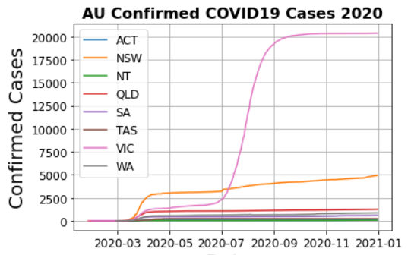


Data Analysis - The COVID Data for 2020
What happened in 2020?

Slide 14

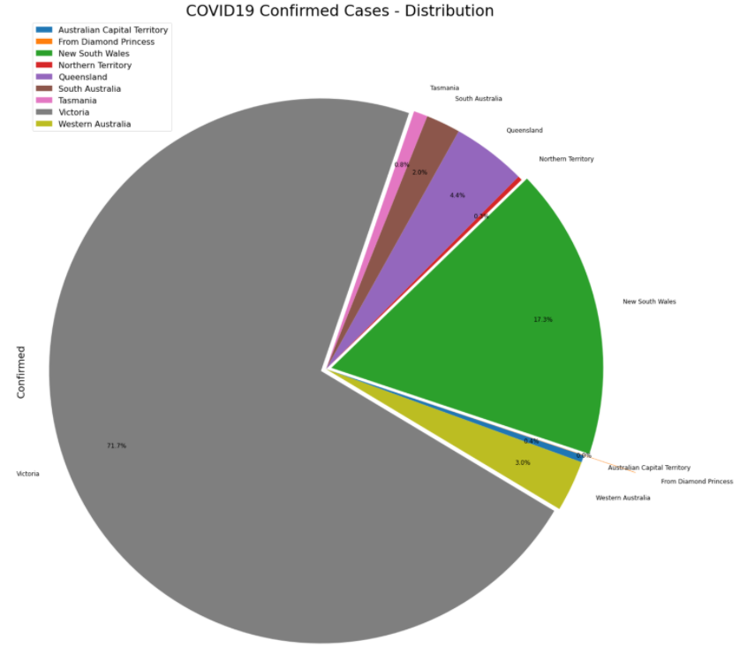
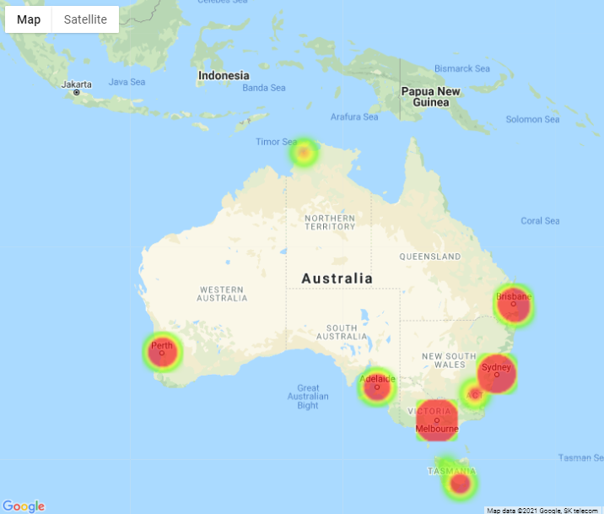
Data Analysis - The COVID Data for 2020
Where was the weight of the COVID19 cases?

Slide 15
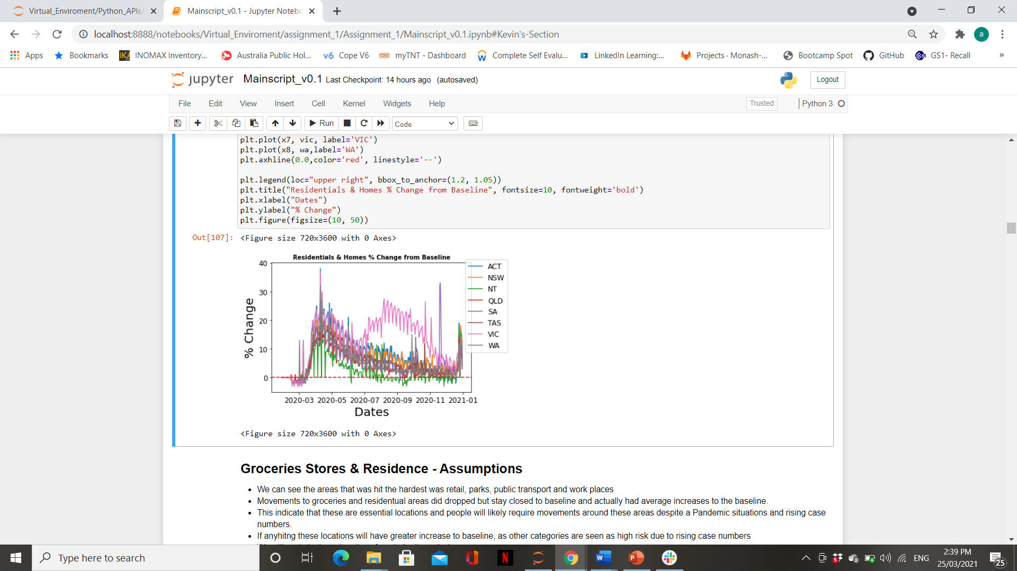
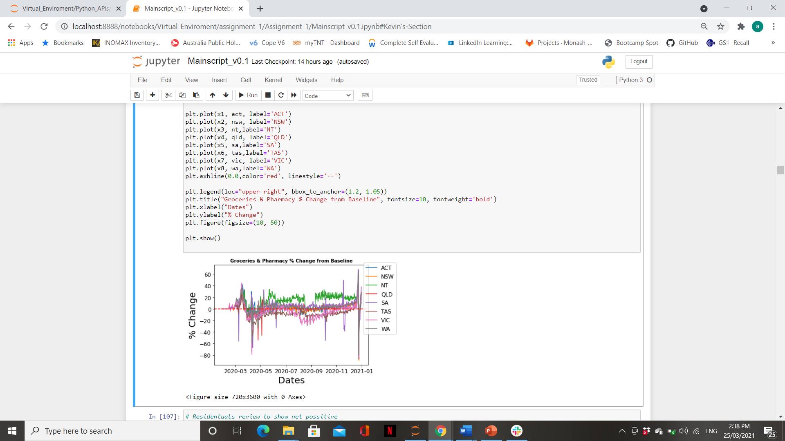

Data Analysis - First Level Data Visualization
Does this look right?
Can we make some quick assumptions, and move on?

Slide 16

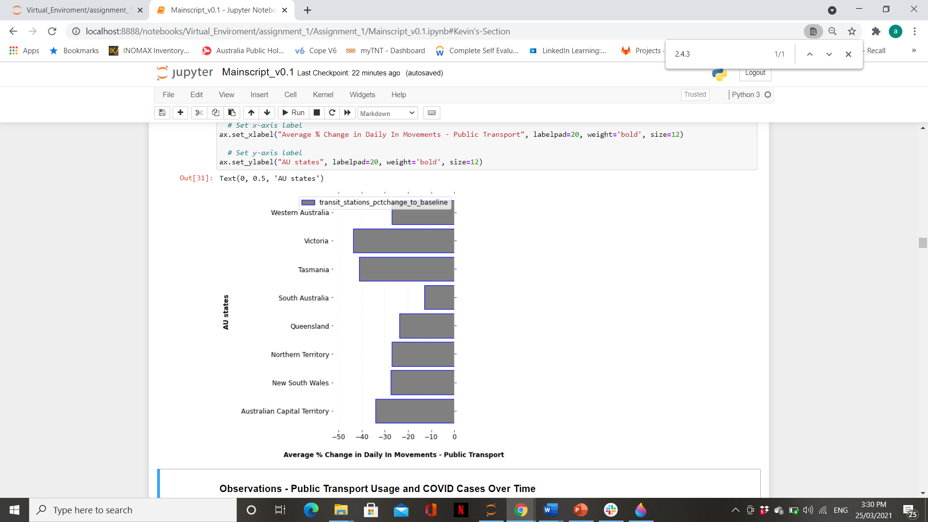
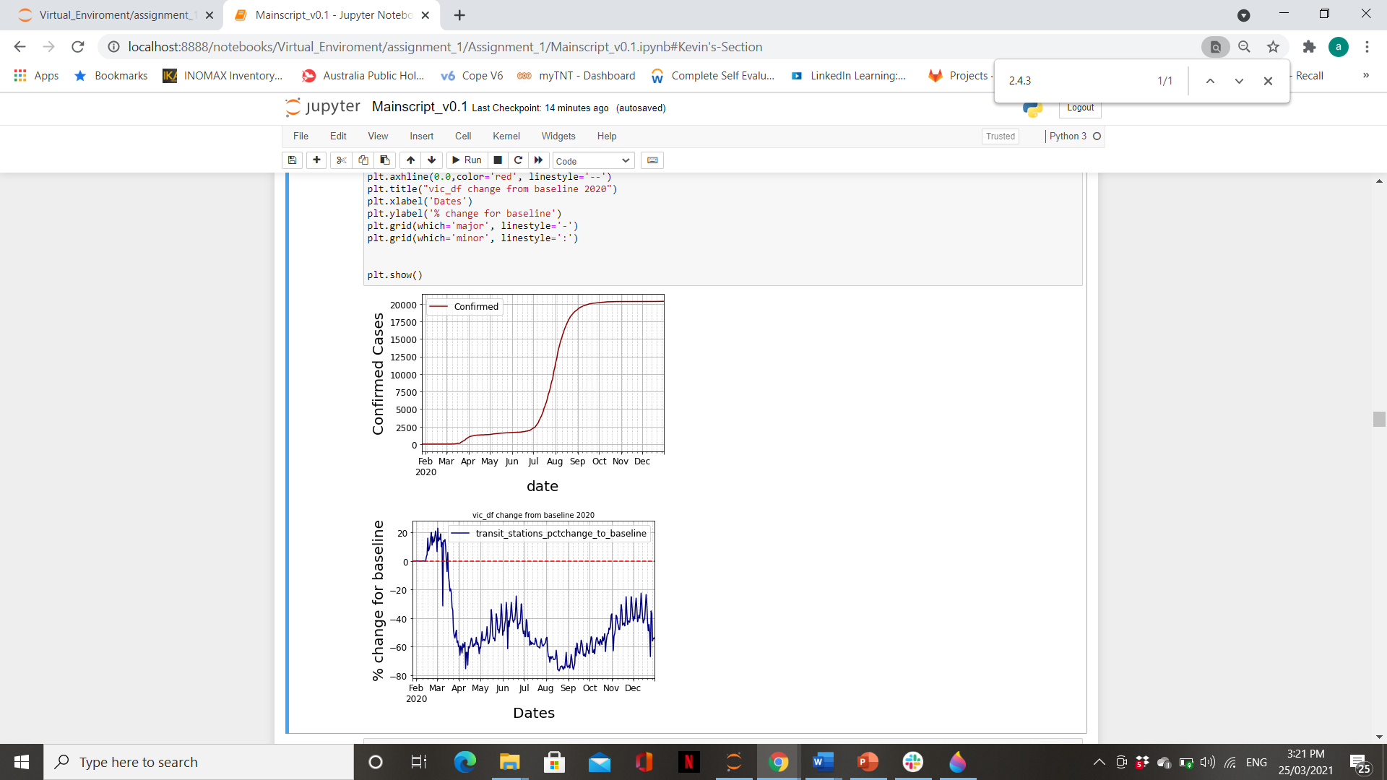
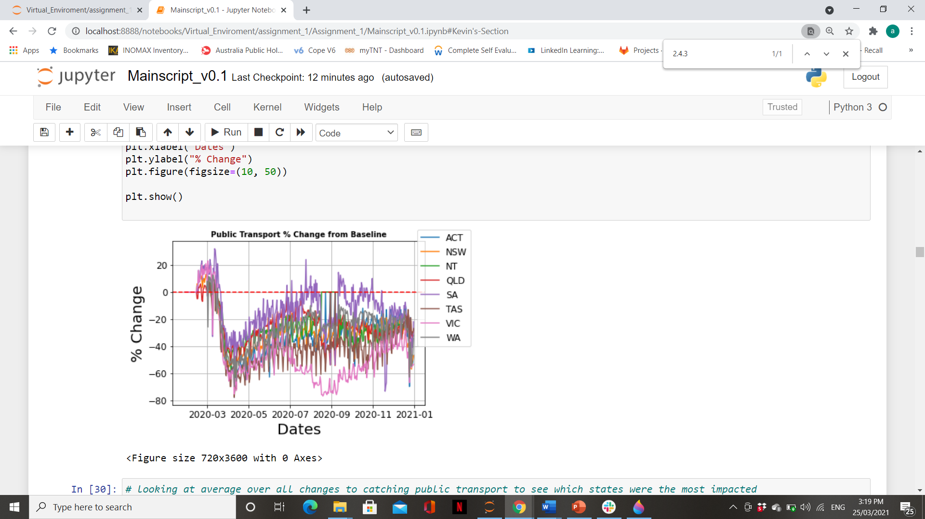
Data Analysis - First Level Data Visualization
Investigate this further?

Slide 17
CORRELATIONS

Slide 18
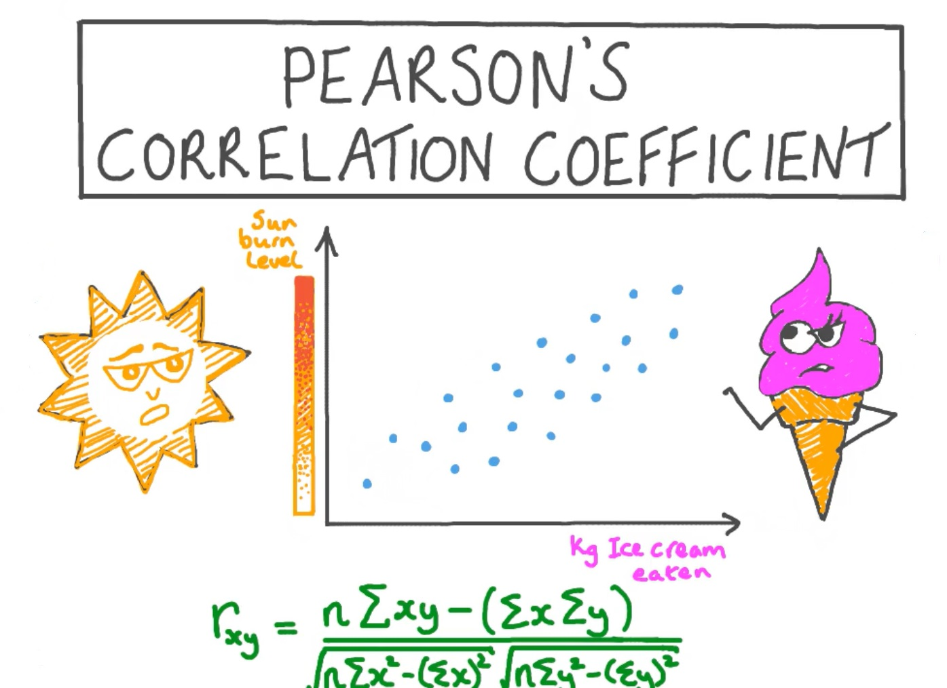

Slide 19
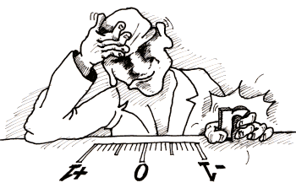
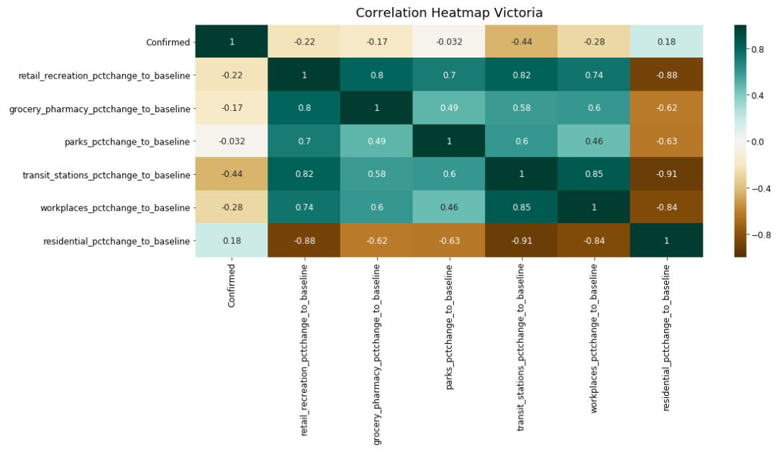
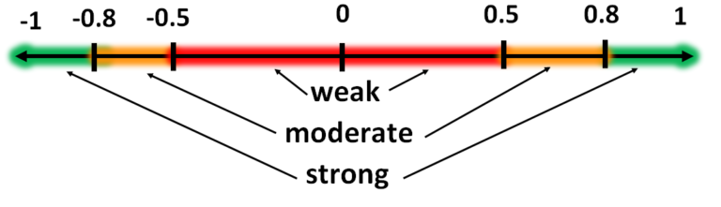
The Heatmap of Victoria

Slide 20
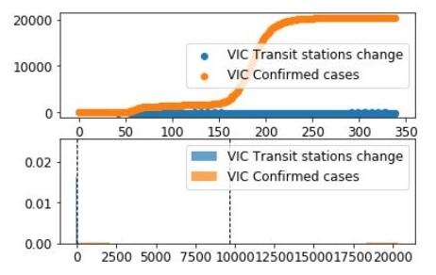
The P-value between Transit station and confirmed cases is 1.5e-58

Slide 21
Trends

Slide 22
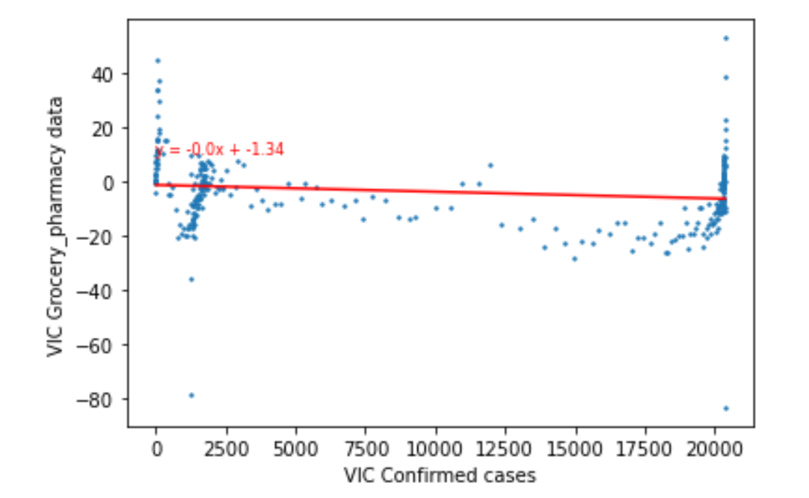
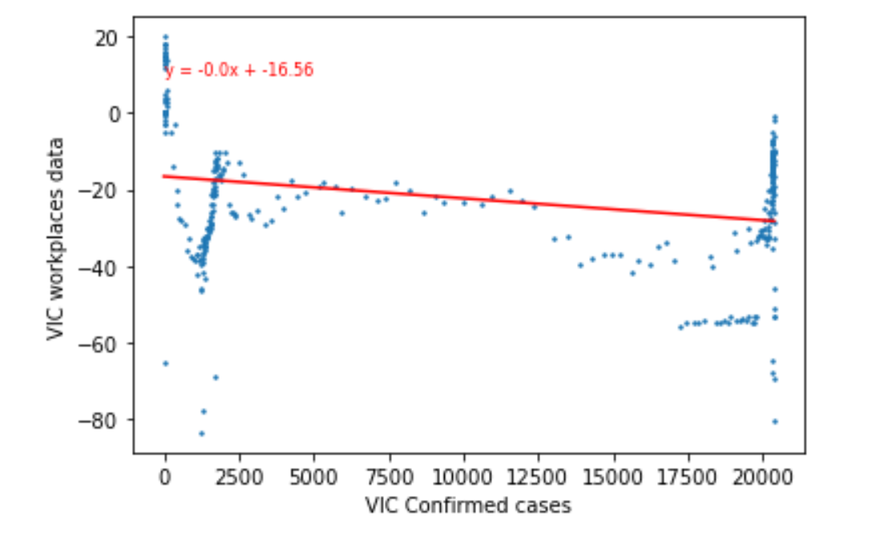
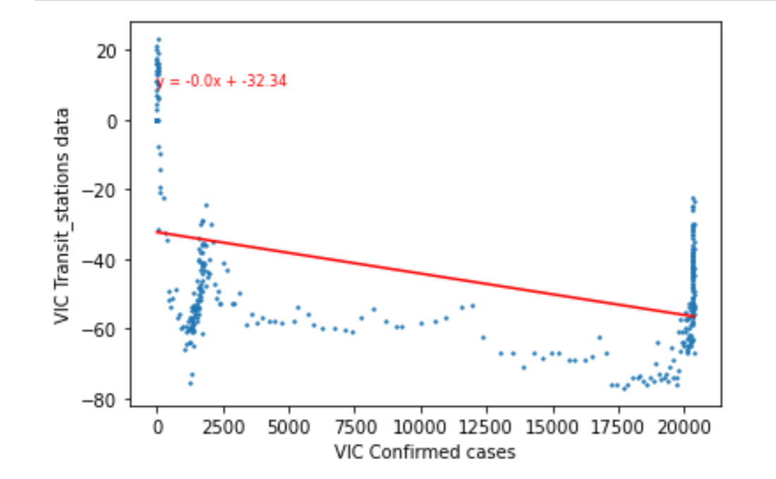
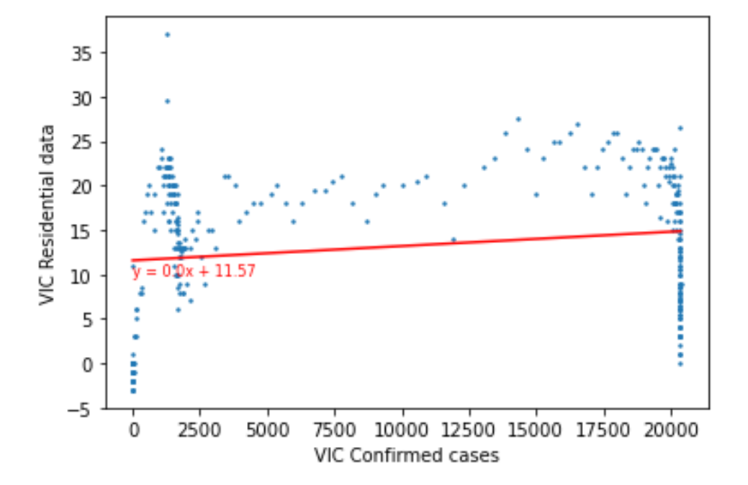
Linear regression charts to analyze trends and forecast - VIC

Slide 23
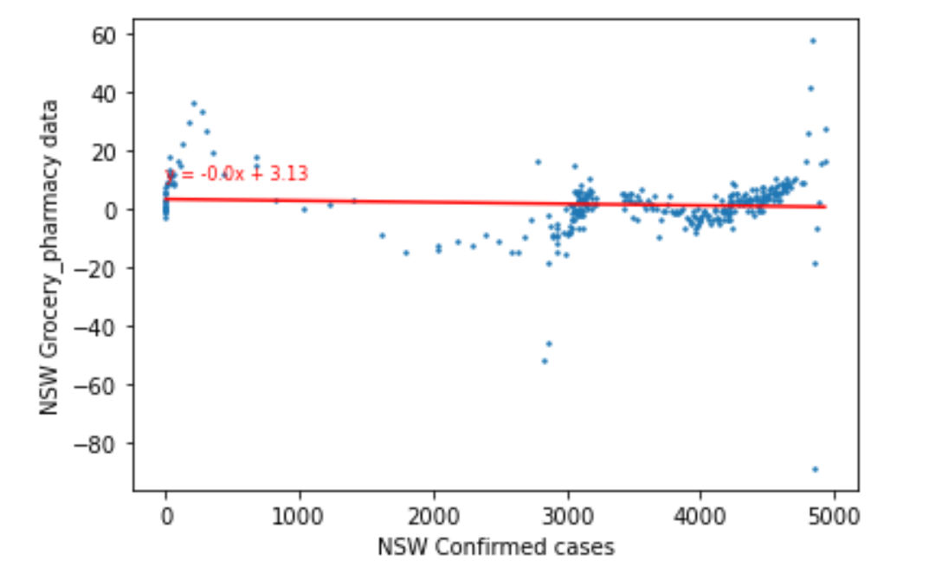
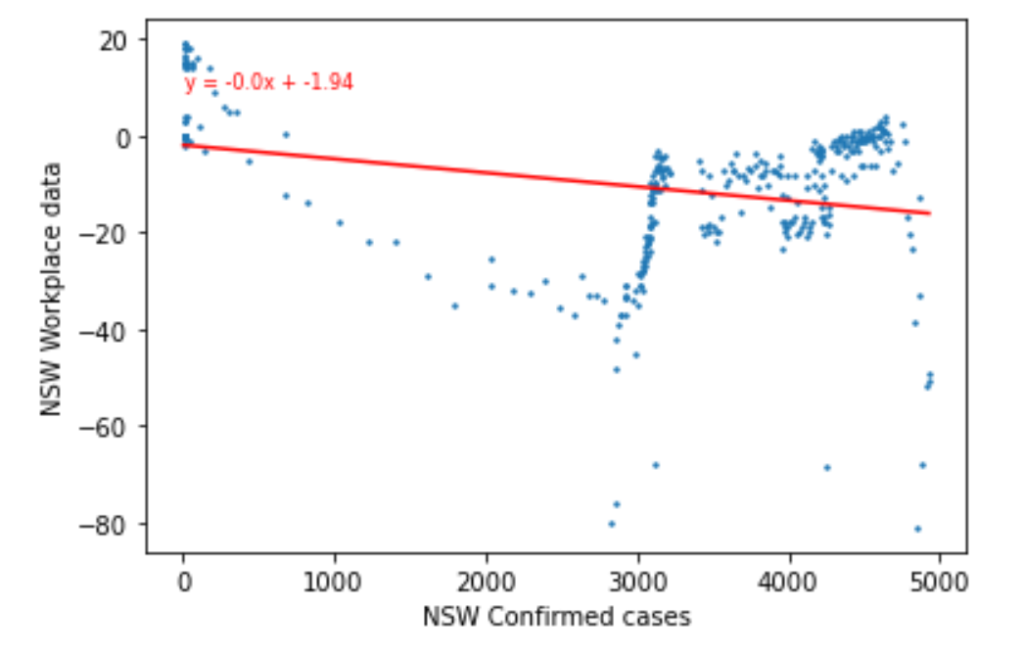
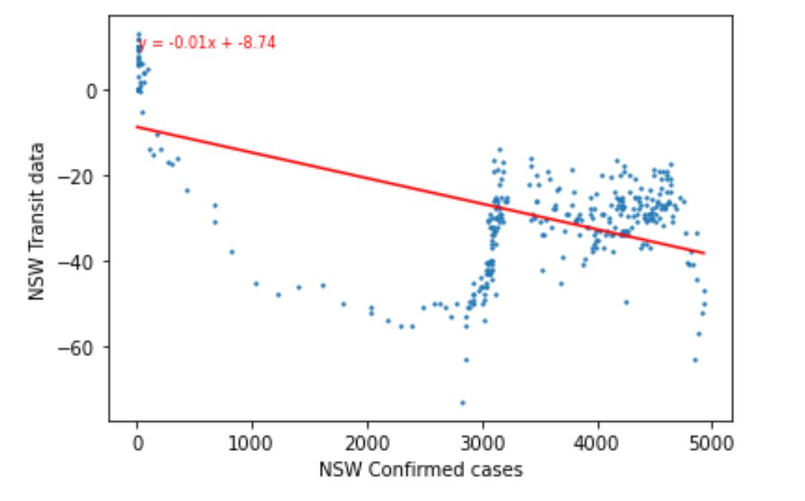
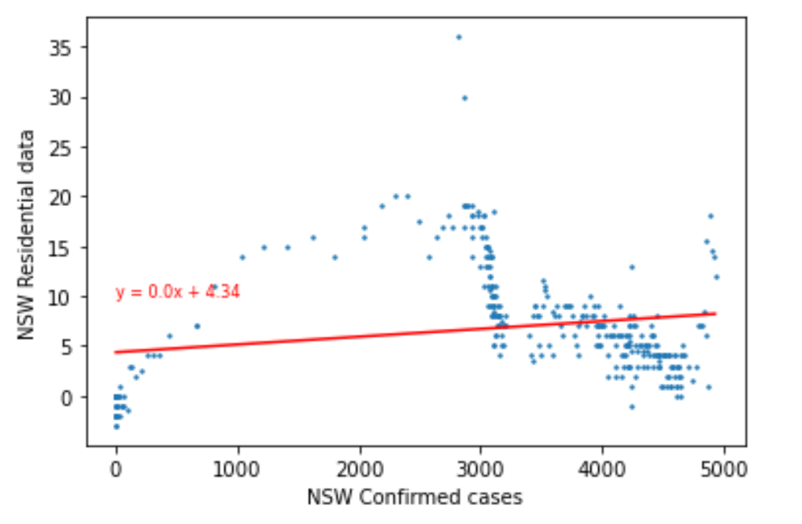
Linear regression charts to analyze trends and forecast - NSW

Slide 24
LIMITATIONS

Slide 25
Due to time constraints the analysis was limited to Australia only. With more time it would have been ideal to perform similar analysis on other high impact countries, eg USA or Japan
The analysis is based on a relatively limited or small public transport network (in Australia) as opposed to countries like Japan who have a comprehensive public transport network.
The mobility data is derived from people who have enabled Google location tracking only.
Some changes in movements could not be explained and there was no apparent link to COVID cases. For example, there were unexplained dips in workplace mobility around June and October in most states. This may have been due to school holidays
As this is a hypothetical company/transport network, we don’t have access to company financial data to see the impact of COVID vs mobility on the company’s financial performance.
The mode of transport is generalized and defined in terms of trains, busses, trams, etc

Slide 26
CONCLUSION

Slide 27
Exponential growth in COVID cases resulted in significant dips in mobility when compared to baseline
We can clearly see that the transit stations had the most negative correlation with confirmed cases. Also the correlation between transit stations and residential is a strong negative.
Victoria clearly showed the most prominent changes which can be attributed to the higher number of COVID cases. We can use Victoria as a good comparison for future situations and measurements.
We found that transit (through the public transport network) was the most affected, followed by mobility to and from workplaces.
We see a strong correlation between changes in mobility through transit stations and workplaces.
Recovery towards baseline strong correlates with a flattening of the curve of COVID cases. We will take this into consideration during any future planning of the transport network

Slide 28
RECOMMENDATIONS

Slide 29
To reduce level of public transports in anticipation of a public announcement that could potentially affect all Australians. i.e. another pandemic or natural disasters.
For Covid an event leading up to rise in number of cases like a super-spreader event. If there are a likelihood of increases in the number of cases. it should be followed by reduction in public transports in anticipation for the dips from baseline of public transport usage.
Once the cases are under control and the curve is flattened for approximately 1 month, begin to slowly introduce more public transport as the usage levels will slowly climb back up towards baseline.

Slide 30
QUESTIONS?

Slide 31
THANK YOU

